Slide 1
Greek Adverbs
Prof. Vanessa Gorman
University of Nebraska-Lincoln
vgorman1@unl.edu

Slide 2
Adverbs
Soon, afterwards, thus, there, well, now, thereupon, etc.
Often translated “-ly.” Warmly, hostilely, quickly, etc.
In English, adverbs are used to modify a verb, adjective, clause, or another adverb. Anything except nouns and pronouns, which are modified by adjectives.
In Greek they can modify anything!

Slide 3
Many things function in the sentence [relation] as adverbs that are not adverbs by part-of-speech [POS].
Prepositional phrases
“Afterwards, they broke camp.”
μετὰ δὲ ταῦτα = after these things; afterwards
Nouns and adjectives in an oblique case
“The next day, they broke camp and marched away.”
τῇ δὲ ὑστεραίᾳ ἡμέρᾳ = on the next day [Dative of time when]
Some adjectives are placed in the accusative without a preposition = adverbial accusative
τότε μὲν ἔφυγον εἰς τὸν Πόντον, ὕστερον δʼ εἰς Ἀθήνας. [2.2.1]
Then they fled to the Pontos, and later to Athens.

Slide 4
Adverbs
As a rule, Greek adverbs are not inflected = indeclinable
Regular adverbs formed by adding –ως to the adjectival stem.
καλός (good) > καλῶς (well)
ἄδικος (unjust) > ἀδίκως (unjustly)
πολέμιος (hostile) > πολεμίως (hostilely)
ἄλλος (other) > ἄλλως (otherwise)
οὗτος (this) > οὕτω/οὕτως (thus)
ὅδε (this) > ὧδε (thus)

Slide 5
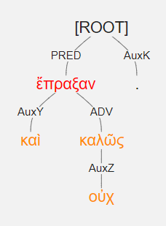
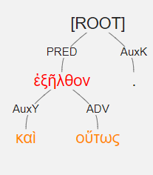
οὐχ καὶ καλῶς ἔπραξαν. [1.7.31]
And they did not act well.
καὶ οὕτως ἐξῆλθον. [2.3.6]
And thus they came out.

Slide 6
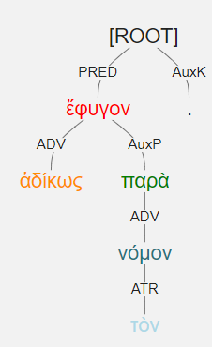
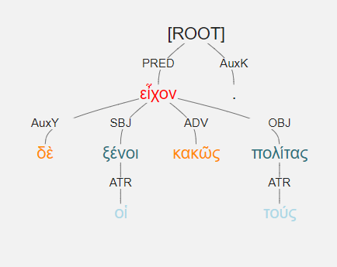
ἀδίκως ἔφυγον παρὰ τὸν νόμον. [1.1.27]
They fled unjustly, contrary to the law.
οἱ δὲ ξένοι κακῶς τούς πολίτας εἶχον.
The foreigners treated the citizens badly.
ἔχω + adverb means “to treat in a certain way.”

Slide 7
Adverbial Place Suffixes
-ι, -θι, -σι denote place where
-θεν denotes place from which
-δε, -σε, -ζε denotes place to which
ὁ οἶκος house (noun)
οἰκεῖος, α, ον domestic (adj)
οἴκοι at home
οἴκοθεν from home
*οἴκαδε homewards
αἱ Ἀθῆναι = Athens (pl. fem.)
Ἀθηναῖος, α, ον Athenian (adj)
Ἀθήνησιν at Athens
Ἀθήνηθεν from Athens
Ἀθήναζε to Athens

Slide 8
Adverbial Place Suffixes
-ι, -θι, -σι denote place where
-θεν denotes place from which
-δε, -σε, -ζε denotes place to which
ἐκεῖνος that (adj)
*ἐκεῖ there
*ἐκεῖθεν from there
ἐκεῖσε to there
οὗτος, αὕτη, τοῦτο = this/that (adj)
*ἐνταῦθα there, then
*ἔνθα there, then
ἐντεῦθεν thereupon, thence, from there

Slide 9
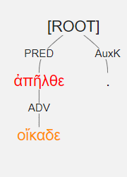
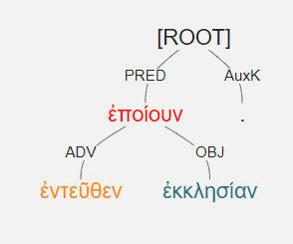
οἴκαδε ἀπῆλθε [3.2.29]
He went away homewards.
ἐντεῦθεν ἐκκλησίαν ἐποίουν. [1.7.9]
Thereupon (then) they made an assembly.

Slide 10
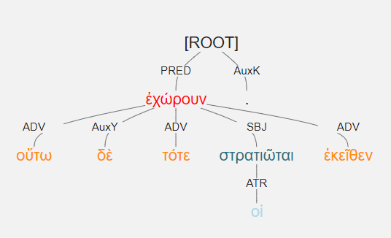
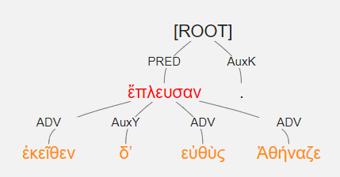
ἐκεῖθεν δʼ εὐθὺς ἔπλευσαν Ἀθήναζε.
From there immediately they sailed to Athens.
οὕτω δὲ τότε οἱ στρατιῶται ἐκεῖθεν ἐχώρουν.
Thus then the soldiers withdrew from there.

Slide 11
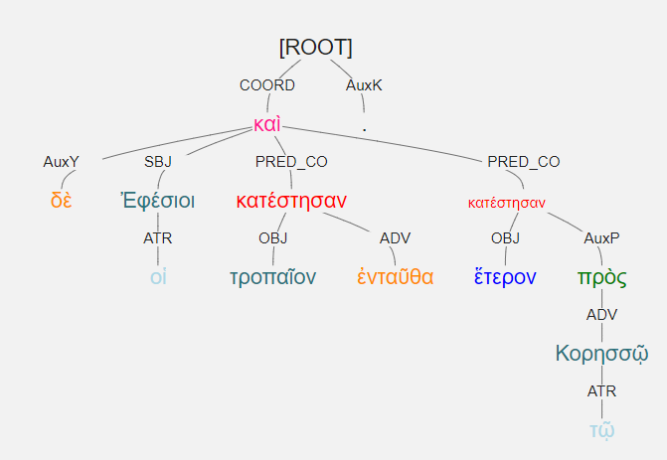
οἱ δὲ Ἐφέσιοι τροπαῖον ἐνταῦθα κατέστησαν καὶ ἕτερον πρὸς τῷ Κορησσῷ. [1.2.10]
The Ephesians set up a trophy there, and another near Koressos.

Slide 12
The most common adverbs are irregular.
 | lemma | translate | count
1 | ἀεί | always | 44
2 | ἅμα | at the same time | 83
3 | αὖ, αὖθις | again | 86
4 | ἐγγύς | near | 28
5 | ἐκεῖ | there | 51
6 | ἐκεῖθεν | from there | 34
7 | ἔνθα | there, then | 41
8 | ἐνταῦθα | there, then | 48
9 | ἔπειτα | then | 35
10 | ἔτι | yet | 98
11 | εὖ | well | 37
12 | εὐθύς, εὐθύ | immediately | 107
13 | ἤδη | already | 111
14 | μάλα | very | 88
15 | μάλιστα | especially | 32
16 | μᾶλλον | more | 67
17 | νῦν | now | 79
18 | οἴκαδε | homewards | 46
19 | οὕτω, οὕτως | thus | 151
20 | πάλιν | again | 96
21 | ποτε, πώποτε | once, yet | 37
22 | πρόσθεν | before | 49
23 | τότε | then | 83

Slide 13
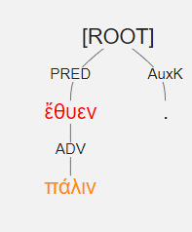
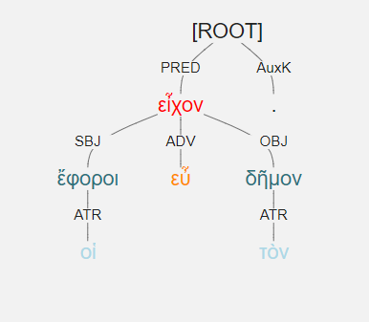
Adverbs [POS] functioning as straightforward adverbs [relation]
πάλιν ἔθυεν.
He was sacrificing again.
οἱ ἔφοροι εὖ εἶχον τὸν δῆμον.
The ephors treated the people well.

Slide 14
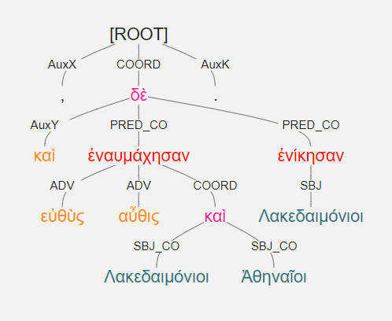
καὶ εὐθὺς ἐναυμάχησαν αὖθις Λακεδαιμόνιοι καὶ Ἀθηναῖοι, ἐνίκησαν δὲ Λακεδαιμόνιοι.
And immediately the Lakedaimonians and the Athenians fought by sea again, and the Lakedaimonians won.

Slide 15
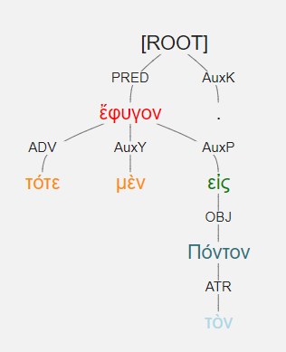
τότε μὲν ἔφυγον εἰς τὸν Πόντον.
Then they fled to the Pontos.

Slide 16
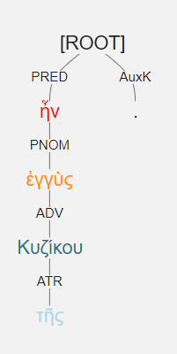
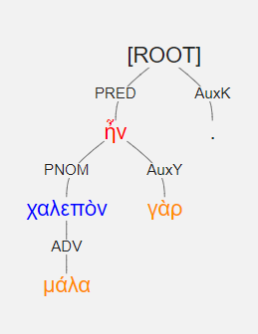
ἐγγὺς τῆς Κυζίκου ἦν.
It was near Kyzikos.
χαλεπὸν γὰρ μάλα ἦν.
It was very difficult.

Slide 17
Adverbs [POS] with other Relations.
We can use an adverb [part-of-speech] to function within the sentence as an ATR or SUBJ/OBJ or PNOM [relation].
“The men then did this and the men now do that,” using adverbs, attributively, to mean the men in previous times as opposed to the men now.

Slide 18
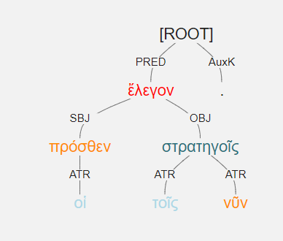
οἱ πρόσθεν τοῖς νῦν στρατηγοῖς ἔλεγον.
The earlier [generals] were speaking to the current generals.

Slide 19
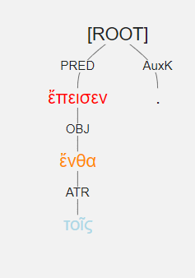
τοῖς ἔνθα ἔπεισεν.
He persuaded the men there.

Slide 20
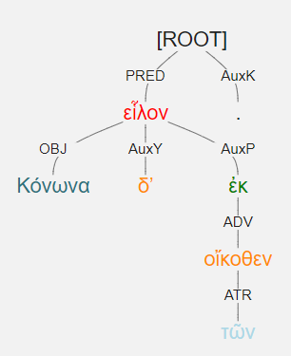
Κόνωνα δʼ ἐκ τῶν οἴκοθεν εἷλον.
They chose Konon from the ones from home.
Object of a prepositional phrase that is acting adverbially

